Slide 1
CSE – 325 Microprocessor, Assembly Language and Computer Interfacing
Syed shakil mahmud
lecturer
Dept. of CSE, baiust

Slide 2

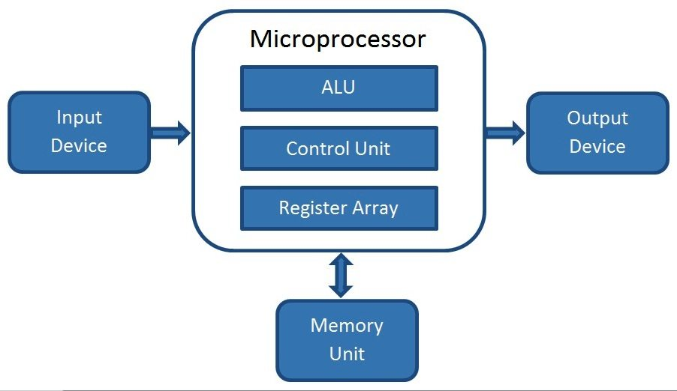
What is Microprocessor
A microprocessor is an integrated circuit (IC) which incorporates core functions of a computer’s central processing unit (CPU). It is a programmable multipurpose silicon chip, clock driven, register based, accepts binary data as input and provides output after processing it as per the instructions stored in the memory.

Slide 3
1st Generation (4-bit Microprocessors)
2nd Generation (8-bit Microprocessors)
Evolution
Of
Microprocessor
3rd Generation (16-bit Microprocessors)
4th Generation (32-bit Microprocessors)
5th Generation (64-bit Microprocessors)

Slide 4
1ST Generation of Microprocessors
It began with the development of 4004 by Intel Corporation in the year of 1971. Example: 4004.
Key features –
It has a bit-width of 4-bits, hence it can process 4-bits of data simultaneously.
It comprises of 2300 transistors.
It has a clock speed of 740 kHz.
Limited instruction set
PMOS technology

Slide 5
2ND Generation of Microprocessors
This started with the development of 8-bit microprocessors with an improved performance and energy efficiency. Example: Intel 8080, 8085.
Key features –
8-bit processors
Clock speed: ~1-3 MHz
NMOS technology (faster than PMOS)
More powerful instruction sets
Introduced interrupt and DMA capabilities

Slide 6
3rd Generation Microprocessors
The third generation is known for development of personal computers. This generation of microprocessors began with the introduction of 16-bit microprocessors that can handle more complex computing tasks and support multitasking.
Key Features –
16-bit processors
Clock speed: up to 10 MHz
Introduced pipelining (basic form)
More memory addressing capability

Slide 7
4th Generation Microprocessors
The fourth generation began with the development of 32-bit microprocessors. This generation reduced the gap between personal computing and professional standards.
Key Features –
32-bit processors
Clock speed: 20 MHz to over 100 MHz
On-chip cache memory
Instruction pipelining and parallelism
Integrated floating-point units

Slide 8
5th Generation Microprocessors
This is the generation of microprocessors started with the development of 64-bit microprocessors, having multiple cores, and emerging capabilities like AI (Artificial Intelligence) and graphics.
Key Features -
64-bit processors
Clock speeds: GHz range
Multi-core architecture
Integrated GPUs, AI acceleration
High-speed computing and multitasking

Slide 9
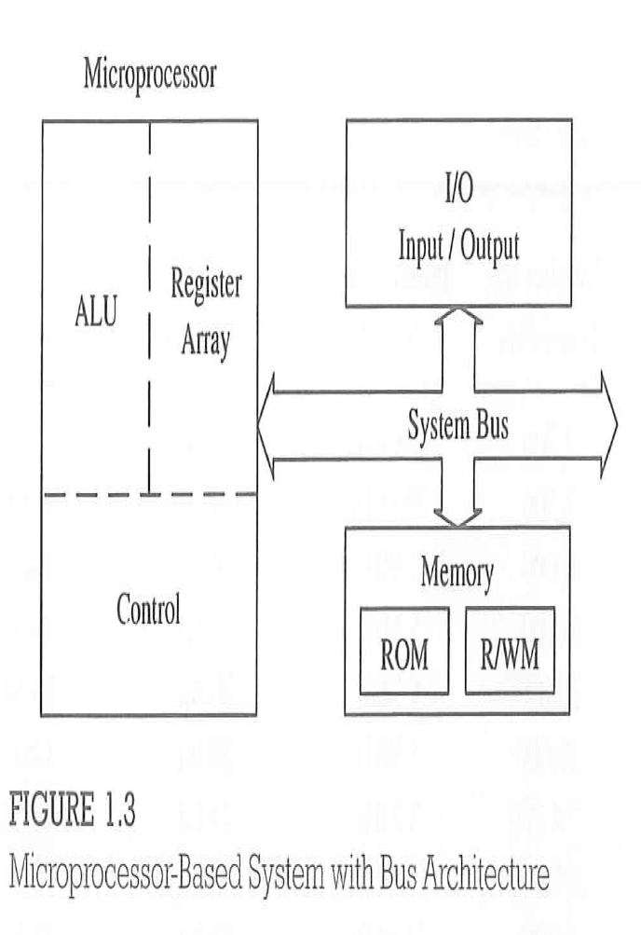
Microprocessor-based System with Bus Architecture

Slide 10
Components of Microprocessor
A microprocessor consists of many components to perform various functions. The following are some key components of a typical microprocessor −
Arithmetic Logic Unit (ALU)
Control Unit (CU)
Registers
Cache Memory
Clock Generator
System Bus

Slide 11
Arithmetic Logic Unit(ALU)
ALU is the most important component of a microprocessor, as it is responsible performing all computing tasks and operations. As its name implies, ALU can perform Arithmetic and Logical operations. It performs the following functionalities −
It allows for executing instructions.
It provides capabilities to manipulate input data and generate desired outputs.
It ensures the speed, efficiency, and overall performance of the microprocessor.

Slide 12
Control Unit (CU)
It is nothing but a digital circuit that directs the flow and execution of instructions and data within a microprocessor. It allows for managing and coordinating the operations of all other components of the system. Control unit compromises of Instruction register, Instruction decoder, Control and Timing Circuit. It performs the following functionalities −
It allows ALU to fetch instructions from memory and load them into instruction register.
It decodes instructions to identify the operations to be performed.
It produces control signals for synchronization and coordination among various components of the microprocessor.
It controls the flow of data and execution of instructions in the correct sequence.

Slide 13
Register
They are high-speed, small-sized storage devices, provided in a microprocessor to hold data and instruction temporarily. It performs the following key functions −
They provide a temporary storage for data to be processed and instructions to be executed.
They also store intermediate outputs/results during computations.
Some common types of registers used in microprocessors −
General Purpose Registers − Temporarily hold data to be processed and intermediate results during calculations.
Special Purpose Registers − Perform a specific task like to store address of next instruction that has to be executed.
Instruction Register − Temporarily store current instructions.
Base and Index Registers − These registers are used for memory addressing purposes.
Flag Registers − Store flags that denote the output of operations in arithmetic logic unit.
Memory Address Registers − These registers store the address of memory locations.
Data Registers − These registers are provided to temporarily store data that are being transferred between memory and the ALU.

Slide 14
Cache memory
Cache memory is also an integral part of modern microprocessors. It is used to enhance the speed and performance of the microprocessor. It creates a high-speed storage layer between the microprocessor and main memory (RAM). In a microprocessor, cache memory stores recent, most frequently used data and instructions. Hence, it reduces the access time and boosts the performance of the microprocessor.

Slide 15
System Bus
It act as a communication channel and connects various components of the microprocessor together. This provides capabilities for flow of data, instructions, and control signals among different parts of the microprocessor. The system buses in a microprocessor can be classified into the following three main types −
Data Bus − It allows for data transfer among the processor, memory unit, and I/O devices. It provides data flow in both directions i.e., from processor to other components and vice-versa.
Address Bus − It carries the addresses of memory locations that the microprocessor requires to access. These are unidirectional buses.
Control Bus − It carries the control signals to and from the microprocessor to manage the entire computing system. It can be unidirectional or bidirectional.

Slide 16
Thank You!

